Slide 1
US Department of Education Office of Elementary and Secondary Education Office of Safe and Supportive Schools
Mental Health Service Professional (MHSP) Grant Program
2022 and 2023 Cohorts
Interim Performance Reporting
August 29, 2024

Slide 2
Housekeeping
Interim Performance Reporting
GPRA Reporting and Tool
Questions
AGENDA

Slide 3
FREQUENCY
MHSP Grantees will submit:
Interim Performance Report (IPR) – annually
Annual Performance Report (APR) – annually, except final year

Slide 4
Interim Performance Report (via G5)
October 11, 2024
Reporting period for this IPR is:
January 1 – September 1, 2024

Slide 5
ED524 Reporting Form
The ED524B is the official reporting form used for discretionary grants at ED.
The form includes instructions and 5 distinct sections:
1-Cover Sheet
2-Executive Summary
3-Section A
4-Section B
5-Section C
You may access these forms and instructions online at: http://www.ed.gov/fund/grant/apply/appforms/appforms.html

Slide 6
ED 524B – Executive Summary
In this section, you will provide a 1-2-page general summary of your MHSP activities.
You should highlight progress towards your project’s goals, and the extent to which expected outcomes and performance measures were achieved.
If project goals and objectives are not being met, you should include information about the challenges affecting implementation.

Slide 8
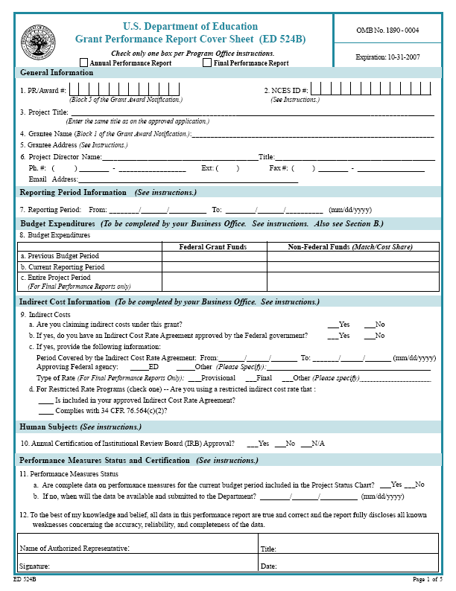
ED524B Reporting Form – Cover Sheet
Be sure to complete line 8, a.
The Reporting Period for this report is:
01/01/2024 – 09/01/2024

Slide 9
ED 524B – Section A (Project Status)
This section requires you to report data for BOTH “Program” and “GPRA” measures.
GPRA measures are established – please do not to change the GPRA language in the Performance Measure section.
When entering data in the “Actual Performance Data” section, please include the Raw Score.

Slide 10
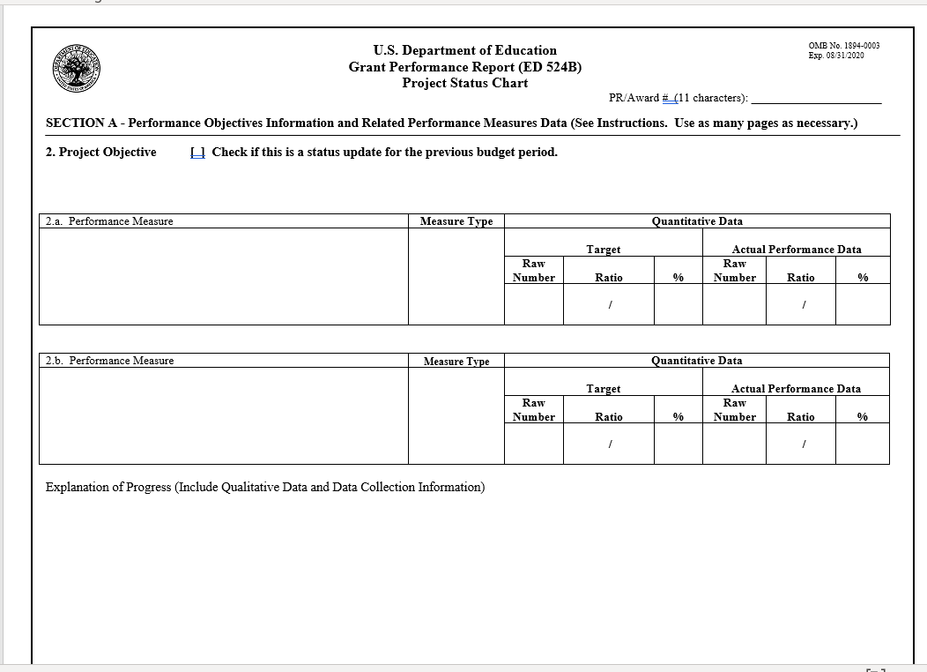

Slide 11
ED 524B – Section A (Project Status)
Use the Explanation of Progress section to provide details (i.e.):
Data-collection procedures,
Data explanations,
Response rates, etc.
If necessary, you may create multiple pages of section A.
If you have no or minimal data to report, use the Explanation of Progress section to provide an explanation.

Slide 12

MHSP GPRA Overview
Training
Placement
Hiring
Competitive Preference Priority 1: Diversity

Slide 13

Key Definition
Unduplicated:
Counts for GPRAs 1, 2, and 3 should be unduplicated. Thus, if you counted a provider toward a GPRA in your Year 1 APR, they should not be counted toward that same GPRA in the Year 2 APR.

Slide 14
GPRA 1: Training
The unduplicated, cumulative number of school-based mental health services providers trained by the grantee under the project to provide school-based mental health services in high-need LEAs.
GPRA 1A: Completed Training
GPRA 1B: In Training (but not complete)
Explanation of Progress:
Describe any successes or challenges in the training process, such as those related to the recruitment and retention of trainees. Also provide information on the nature of training being provided.

Slide 15
GPRA 1: Example
MHSP Trainees | Year 1 | Year 2
Jane | Started Training | Returned & Completed Training
Alex | Started Training | Returned for Training but Didn’t Complete
Jaquon |  | Started Training
Sherman |  | Started Training
Eliza |  | Started Training
GPRA 1A | 0 | 1
GPRA 1B | 2 | 3

Slide 16
GPRA 2: Placement
The unduplicated, cumulative number of school-based mental health services providers placed in a practicum or internship by the grantee in high-need LEAs to provide school-based mental health services.
GPRA 2A: In Placement
GPRA 2B: Completed All Placements
Explanation of Progress
Describe any successes or challenges in the practicum or internship process. Also, provide information on the nature of the practicum and internship experiences.
Notes:
GPRA 2A:
A trainee did not need to complete the practicum experience to be included in this count; they just needed to be placed.
If a trainee was placed in practicum during the start of the reporting period and transitioned to internship by the end of the reporting period, that trainee is still only counted once under GPRA 2A. Similarly, if the trainee changed practicum or internship placements during this reporting period, they are only counted once toward GPRA 2A.
GPRA 2B:
If a student completed their required practicum during this reporting period but still needs to complete an internship to receive their degree, they should not be counted toward GPRA 2B during this reporting period.
If a student completed their practicum during a previous reporting period and then completed their internship during this reporting period (thus ending all placement requirements), they can be counted toward GPRA 2B.

Slide 17
GPRA 2: Example
MHSP Trainees | Year 1 | Year 2
Amina | Started Practicum/Internship | Returned & Completed Practicum/Internship
Kai | Started Practicum/Internship | Returned for Practicum/Internship but Didn’t Complete
Luca | Started Practicum/Internship | Returned but Left Practicum/Internship
Sofia |  | Started Practicum/Internship
James |  | Started Practicum/Internship
Nia |  | Started Practicum/Internship
Ravi |  | Started Practicum/Internship
GPRA 2A | 3 | 4
GPRA 2B | 0 | 1

Slide 18
GPRA 3: Hiring
The unduplicated, cumulative number of school-based mental health services providers hired by high-need LEAs to provide school-based mental health services.
GPRA 3A: Hired
GPRA 3B: Retained
Explanation of Progress
Describe any successes or challenges in the hiring process. Also note if this GPRA is not yet relevant to your project if all trainees were still in training during this reporting period.
Notes:
GPRA 3A
If a trainee was hired but left the position before the end of the reporting period, they should still be counted under GPRA 3A.
GPRA 3B
If your Year 1 APR included a GPRA 3A count that was equal to or greater than 1, Year 2 GPRA 3B should be the number of those trainees that were retained in their position this reporting period. You can count any trainee that stayed in their position throughout this reporting period. You can also count trainees that left their initial position for a different position within the partnering organization (e.g., LEA).
If your Year 1 APR included a GPRA 3A count equal to zero, your GPRA 3B total this year should be zero.

Slide 19
GPRA 3: Example
MHSP Trainees | Year 1 | Year 2
Carlos | Not Hired | Hired
Yasmin | Not Hired | Hired
Liu | Hired | Retained
David | Hired | Not Retained
Lisa | Hired | Retained
GPRA 3A | 3 | 2
GPRA 3B | 0 | 2

Slide 20
GPRA 4: Diversity
Competitive Preference Priority 1
To meet this priority, applicants must propose a plan to increase the number of credentialed school-based mental health services providers in LEAs with demonstrated need who are from diverse backgrounds or who are from communities served by the LEAs with demonstrated need.

Slide 21
GPRA 4: Diversity
For grantees that addressed Competitive Preference Priority 1, the number of such grantees that met their goal of increasing the diversity of school-based mental health services providers.
Enter 999 for raw target and actual numbers
Explanation of Progress
Indicate whether you intended to address this performance measure (Yes/No).
Also, specify whether you met your annual target goal for increasing the diversity of school-based mental health service providers in participating LEAs (Yes/No).
Finally, please share how you defined diversity and provide information related to hired providers.
Notes:
The MHSP program office does not require that grantees provide numerical information for GPRA 4. Rather, they ask grantees to provide information in the Explanation of Progress section, as described below.
However, G5/G6 requires grantees to provide numerical information in the Section A tables for GPRA 4. Therefore, the MHSP program office instructs grantees to input "999" in the raw number cells for both target and actual performance data.

Slide 22
GPRA 4: Example
SBMH Providers | Year 1 | Year 2
Kwame | Underrepresented Group
Leila | Underrepresented Group
Santiago | Underrepresented Group
Hanae | Underrepresented Group
Mark |  | Not Underrepresented Group
Stephanie |  | Not Underrepresented Group
Nia |  | Underrepresented Group
Jerome |  | Underrepresented Group
GPRA 6 | 999 | 999

Slide 23
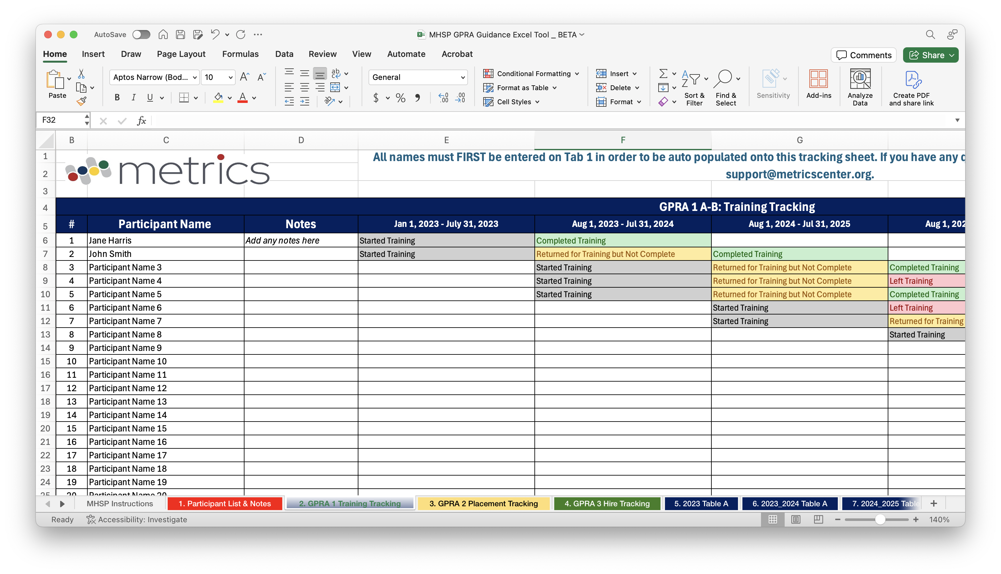
GPRA Guidance Tool

Slide 24
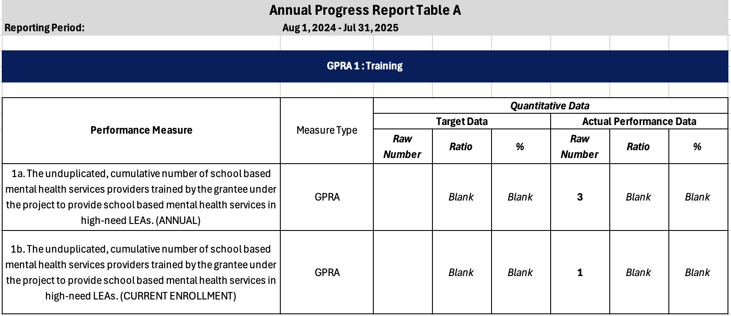
GPRA Guidance Tool

Slide 25
PERFORMANCE MEASURES
Under the Government Performance and Results Act (GPRA), performance measures have been established to evaluate the overall effectiveness of the MHSP Grant Program.
The GPRA measures for this program are:
The unduplicated, cumulative number of school-based mental health services providers trained by the grantee under the project to provide school-based mental health services in high-need LEAs.
The unduplicated, cumulative number of school-based mental health services providers placed in a practicum or internship by the grantee in high-need LEAs to provide school-based mental health services.
The unduplicated, cumulative number of school-based mental health services providers hired by high-need LEAs to provide school-based mental health services.
For grantees that address Competitive Preference Priority 1, the percent of such grantees that meet their annual diversity goal under the grant.

Slide 26
ED 524B – Section B (Budget)
You will use this section to discuss all spending for the reporting period. The reporting period for this IPR is:
January 1, 2024 – September 1, 2024
We will also provide you with a Budget Expenditure Spreadsheet . We encourage you to use this sheet, as it can provide some detailed information pertinent to our review of your report.
NOTE: The spreadsheet does not replace the narrative you are to provide in Section B.

Slide 27
ED 524B – Section B (Budget)
If you expect to have any unexpended funds by the end of the current budget period (December 31, 2024), you will use this section to discuss how much funding you anticipate remaining and why you believe those funds will not be expended by the end of the budget period.
If you wish to use any of the remaining unexpended funds you have identified in your next budget period, you must indicate the amount of the funding that you want to “carryover” as well as how you plan to use these “carryover” funds in the next budget period to complete activities in your approved application.

Slide 28
ED 524B – Section C
FOR THIS REPORT, USE SECTION C TO ADDRESS THE FOLLOWING:
Provide list of IHE or high-need LEA partners.
Identify grant activities that were not implemented due to unforeseen activities.
Detail any challenges to grant activities.

Slide 29

When sending emails to your Federal Project Officer, please include your PR award # in the subject line.

Slide 30
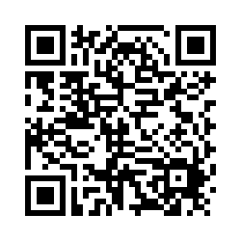
Exit Ticket
How did we do?

Slide 31

Questions….
31

